Slide 1
Chapter 6
Data Types

Slide 2
Chapter 6 Topics
Introduction
Primitive Data Types
Character String Types
User-Defined Ordinal Types
Array Types
Associative Arrays
Record Types
Tuple Types
List Types
Union Types
Pointer and Reference Types
Type Checking
Strong Typing
Type Equivalence
Theory and Data Types
Copyright © 2012 Addison-Wesley. All rights reserved.
1-<number>

Slide 3
Introduction
A data type defines a collection of data objects and a set of predefined operations on those objects
A descriptor is the collection of the attributes of a variable
An object represents an instance of a user-defined (abstract data) type
One design issue for all data types: What operations are defined and how are they specified?
Copyright © 2012 Addison-Wesley. All rights reserved.
1-<number>

Slide 4
Primitive Data Types
Almost all programming languages provide a set of primitive data types
Primitive data types: Those not defined in terms of other data types
Some primitive data types are merely reflections of the hardware
Others require only a little non-hardware support for their implementation
Copyright © 2012 Addison-Wesley. All rights reserved.
1-<number>

Slide 5
Primitive Data Types: Integer
Almost always an exact reflection of the hardware so the mapping is trivial
There may be as many as eight different integer types in a language
Java’s signed integer sizes: byte, short, int, long
Copyright © 2012 Addison-Wesley. All rights reserved.
1-<number>

Slide 6
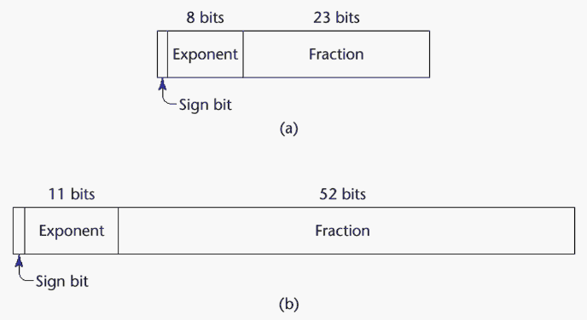
Primitive Data Types: Floating Point
Model real numbers, but only as approximations
Languages for scientific use support at least two floating-point types (e.g., float and double; sometimes more
Usually exactly like the hardware, but not always
IEEE Floating-Point
Standard 754
Copyright © 2012 Addison-Wesley. All rights reserved.
1-<number>

Slide 7
Primitive Data Types: Complex
Some languages support a complex type, e.g., C99, Fortran, and Python
Each value consists of two floats, the real part and the imaginary part
Literal form (in Python):
(7 + 3j), where 7 is the real part and 3 is the imaginary part
Copyright © 2012 Addison-Wesley. All rights reserved.
1-<number>

Slide 8
Primitive Data Types: Decimal
For business applications (money)
  Essential to COBOL
  C# offers a decimal data type
Store a fixed number of decimal digits, in coded form
Advantage: accuracy
      Compared to floating-point types, the decimal type has more precision and a smaller range, which makes it appropriate for financial and monetary calculations.
Disadvantages: limited range, wastes memory
Copyright © 2012 Addison-Wesley. All rights reserved.
1-<number>

Slide 9
Primitive Data Types: Boolean
Simplest of all
Range of values: two elements, one for “true” and one for “false”
Could be implemented as bits, but often as bytes
  Advantage: readability
Copyright © 2012 Addison-Wesley. All rights reserved.
1-<number>

Slide 10
Primitive Data Types: Character
Stored as numeric codings
Most commonly used coding: ASCII
An alternative, 16-bit coding: Unicode (UCS-2)
  Includes characters from most natural languages
  Originally used in Java
  C# and JavaScript also support Unicode
32-bit Unicode (UCS-4)
  Supported by Fortran, starting with 2003
Copyright © 2012 Addison-Wesley. All rights reserved.
1-<number>

Slide 11
Character String Types
Values are sequences of characters
Design issues:
  Is it a primitive type or just a special kind of array?
  Should the length of strings be static or dynamic?
Copyright © 2012 Addison-Wesley. All rights reserved.
1-<number>

Slide 12
Character String Types Operations
Typical operations:
  Assignment and copying
  Comparison (=, >, etc.)
  Concatenation
  Substring reference
  Pattern matching
Copyright © 2012 Addison-Wesley. All rights reserved.
1-<number>

Slide 13
Character String Type in Certain Languages
C and C++
  Not primitive
  Use char arrays and a library of functions that provide operations
SNOBOL4 (a string manipulation language)
  Primitive
  Many operations, including elaborate pattern matching
Fortran and Python
  Primitive type with assignment and several operations
Java
  Primitive via the String class
Perl, JavaScript, Ruby, and PHP
- Provide built-in pattern matching, using regular
expressions
Copyright © 2012 Addison-Wesley. All rights reserved.
1-<number>

Slide 14
Character String Length Options
Static: COBOL, Java’s String class
Limited Dynamic Length: C and C++
  In these languages, a special character is used to indicate the end of a string’s characters, rather than maintaining the length
Dynamic (no maximum): SNOBOL4, Perl, JavaScript
Ada supports all three string length options
Copyright © 2012 Addison-Wesley. All rights reserved.
1-<number>

Slide 15
Character String Type Evaluation
Aid to writability
As a primitive type with static length, they are inexpensive to provide--why not have them?
Dynamic length is nice, but is it worth the expense?
Copyright © 2012 Addison-Wesley. All rights reserved.
1-<number>

Slide 16
Character String Implementation
Static length: compile-time descriptor
Limited dynamic length: may need a run-time descriptor for length (but not in C and C++)
Dynamic length: need run-time descriptor; allocation/deallocation is the biggest implementation problem
Copyright © 2012 Addison-Wesley. All rights reserved.
1-<number>

Slide 17
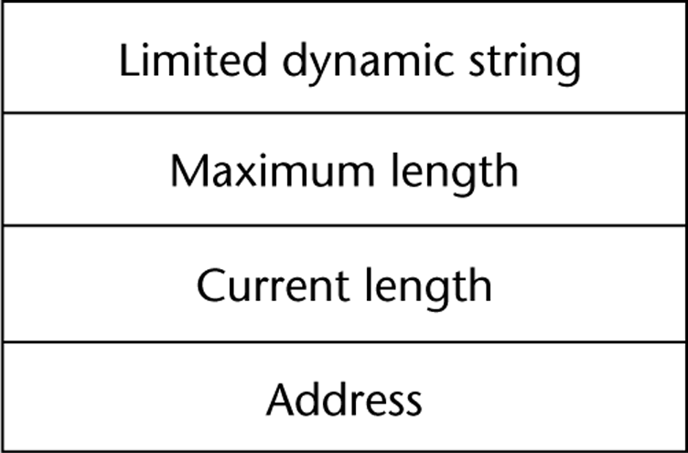
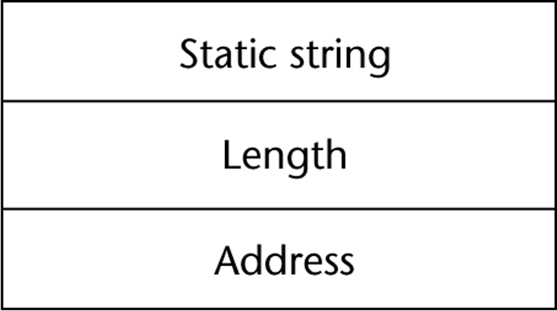
Compile- and Run-Time Descriptors
Compile-time descriptor for static strings
Run-time descriptor for limited dynamic strings
Copyright © 2012 Addison-Wesley. All rights reserved.
1-<number>

Slide 18
User-Defined Ordinal Types
An ordinal type is one in which the range of possible values can be easily associated with the set of positive integers
Examples of primitive ordinal types in Java
  integer
  char
  boolean
Copyright © 2012 Addison-Wesley. All rights reserved.
1-<number>

Slide 19
Enumeration Types
All possible values, which are named constants, are provided in the definition
C# example
  enum days {mon, tue, wed, thu, fri, sat, sun};
Design issues
  Is an enumeration constant allowed to appear in more than one type definition, and if so, how is the type of an occurrence of that constant checked?
  Are enumeration values coerced to integer?
  Any other type coerced to an enumeration type?
Copyright © 2012 Addison-Wesley. All rights reserved.
1-<number>

Slide 20
Evaluation of Enumerated Type
Aid to readability, e.g., no need to code a color as a number
Aid to reliability, e.g., compiler can check:
  operations (don’t allow colors to be added)
  No enumeration variable can be assigned a value outside its defined range
  Ada, C#, and Java 5.0 provide better support for enumeration than C++ because enumeration type variables in these languages are not coerced into integer types
Copyright © 2012 Addison-Wesley. All rights reserved.
1-<number>

Slide 21
Subrange Types
An ordered contiguous subsequence of an ordinal type
  Example: 12..18 is a subrange of integer type
Ada’s design
  type Days is (mon, tue, wed, thu, fri, sat, sun);
  subtype Weekdays is Days range mon..fri;
  subtype Index is Integer range 1..100;
  Day1: Days;
  Day2: Weekday;
  Day2 := Day1;
Copyright © 2012 Addison-Wesley. All rights reserved.
1-<number>

Slide 22
Subrange Evaluation
Aid to readability
  Variables of subrange can store only certain range of values
Reliability
  Assigning a value to a subrange variable that is outside the specified range is detected as an error
Copyright © 2012 Addison-Wesley. All rights reserved.
1-<number>

Slide 23
Array Types
An array is a homogeneous aggregate of data elements in which an individual element is identified by its position in the aggregate, relative to the first element.
Copyright © 2012 Addison-Wesley. All rights reserved.
1-<number>

Slide 24
Array Design Issues
What types are legal for subscripts?
Are subscripting expressions in element references range checked?
When are subscript ranges bound?
When does allocation take place?
Are ragged or rectangular multidimensional arrays allowed, or both?
What is the maximum number of subscripts?
Can array objects be initialized?
Are any kind of slices supported?
Copyright © 2012 Addison-Wesley. All rights reserved.
1-<number>

Slide 25
Array Indexing
Indexing (or subscripting) is a mapping from indices to elements
array_name (index_value_list) → an element
Index Syntax
  Fortran and Ada use parentheses
    Ada explicitly uses parentheses to show uniformity between array references and function calls because both are mappings
  Most other languages use brackets
Copyright © 2012 Addison-Wesley. All rights reserved.
1-<number>

Slide 26
Arrays Index (Subscript) Types
FORTRAN, C: integer only
Ada: integer or enumeration (includes Boolean and char)
Java: integer types only
Index range checking
- C, C++, Perl, and Fortran do not specify
range checking
- Java, ML, C# specify range checking
- In Ada, the default is to require range
checking, but it can be turned off
Copyright © 2012 Addison-Wesley. All rights reserved.
1-<number>

Slide 27
Subscript Binding and Array Categories
Static: subscript ranges are statically bound and storage allocation is static (before run-time)
  Advantage: efficiency (no dynamic allocation)
Fixed stack-dynamic: subscript ranges are statically bound, but the allocation is done at declaration time
  Advantage: space efficiency
Copyright © 2012 Addison-Wesley. All rights reserved.
1-<number>

Slide 28
Subscript Binding and Array Categories (continued)
Stack-dynamic: subscript ranges are dynamically bound and the storage allocation is dynamic (done at run-time)
  Advantage: flexibility (the size of an array need not be known until the array is to be used)
Fixed heap-dynamic: similar to fixed stack-dynamic: storage binding is dynamic but fixed after allocation (i.e., binding is done when requested and storage is allocated from heap, not stack)
Copyright © 2012 Addison-Wesley. All rights reserved.
1-<number>

Slide 29
Subscript Binding and Array Categories (continued)
Heap-dynamic: binding of subscript ranges and storage allocation is dynamic and can change any number of times
  Advantage: flexibility (arrays can grow or shrink during program execution)
Copyright © 2012 Addison-Wesley. All rights reserved.
1-<number>

Slide 30
Subscript Binding and Array Categories (continued)
C and C++ arrays that include static modifier are static
C and C++ arrays without static modifier are fixed stack-dynamic
C and C++ provide fixed heap-dynamic arrays
C# includes a second array class ArrayList that provides fixed heap-dynamic
Perl, JavaScript, Python, and Ruby support heap-dynamic arrays
Copyright © 2012 Addison-Wesley. All rights reserved.
1-<number>

Slide 31
Array Initialization
Some language allow initialization at the time of storage allocation
  C, C++, Java, C# example
  int list [] = {4, 5, 7, 83}
  Character strings in C and C++
  char name [] = ″freddie″;
  Arrays of strings in C and C++
  char *names [] = {″Bob″, ″Jake″, ″Joe″];
  Java initialization of String objects
  String[] names = {″Bob″, ″Jake″, ″Joe″};
Copyright © 2012 Addison-Wesley. All rights reserved.
1-<number>

Slide 32
Heterogeneous Arrays
A heterogeneous array is one in which the elements need not be of the same type
Supported by Perl, Python, JavaScript, and Ruby
Copyright © 2012 Addison-Wesley. All rights reserved.
1-<number>

Slide 33
Array Initialization
C-based languages
  int list [] = {1, 3, 5, 7}
  char *names [] = {″Mike″, ″Fred″, ″Mary Lou″};
Ada
  List : array (1..5) of Integer :=
  (1 => 17, 3 => 34, others => 0);
Python
  List comprehensions
  list = [x ** 2 for x in range(12) if x % 3 == 0]
  puts [0, 9, 36, 81] in list
Copyright © 2012 Addison-Wesley. All rights reserved.
1-<number>

Slide 34
Arrays Operations
APL provides the most powerful array processing operations for vectors and matrixes as well as unary operators (for example, to reverse column elements)
Ada allows array assignment but also catenation
Python’s array assignments, but they are only reference changes. Python also supports array catenation and element membership operations
Ruby also provides array catenation
Fortran provides elemental operations because they are between pairs of array elements
  For example, + operator between two arrays results in an array of the sums of the element pairs of the two arrays
Copyright © 2012 Addison-Wesley. All rights reserved.
1-<number>

Slide 35
Rectangular and Jagged Arrays
A rectangular array is a multi-dimensioned array in which all of the rows have the same number of elements and all columns have the same number of elements
A jagged matrix has rows with varying number of elements
  Possible when multi-dimensioned arrays actually appear as arrays of arrays
C, C++, and Java support jagged arrays
Fortran, Ada, and C# support rectangular arrays (C# also supports jagged arrays)
Copyright © 2012 Addison-Wesley. All rights reserved.
1-<number>

Slide 36
Slices
A slice is some substructure of an array; nothing more than a referencing mechanism
Slices are only useful in languages that have array operations
Copyright © 2012 Addison-Wesley. All rights reserved.
1-<number>

Slide 37
Slice Examples
Python
  vector = [2, 4, 6, 8, 10, 12, 14, 16]
  mat = [[1, 2, 3], [4, 5, 6], [7, 8, 9]]
  vector (3:6) is a three-element array
  mat[0][0:2] is the first and second element of the first row of mat
Ruby supports slices with the slice method
  list.slice(2, 2) returns the third and fourth elements of list
Copyright © 2012 Addison-Wesley. All rights reserved.
1-<number>

Slide 38
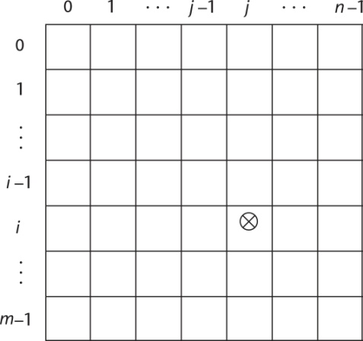
Implementation of Arrays
Access function maps subscript expressions to an address in the array
Access function for single-dimensioned arrays:
address(list[k]) = address (list[lower_bound])
+ ((k-lower_bound) * element_size)
Copyright © 2012 Addison-Wesley. All rights reserved.
1-<number>

Slide 39
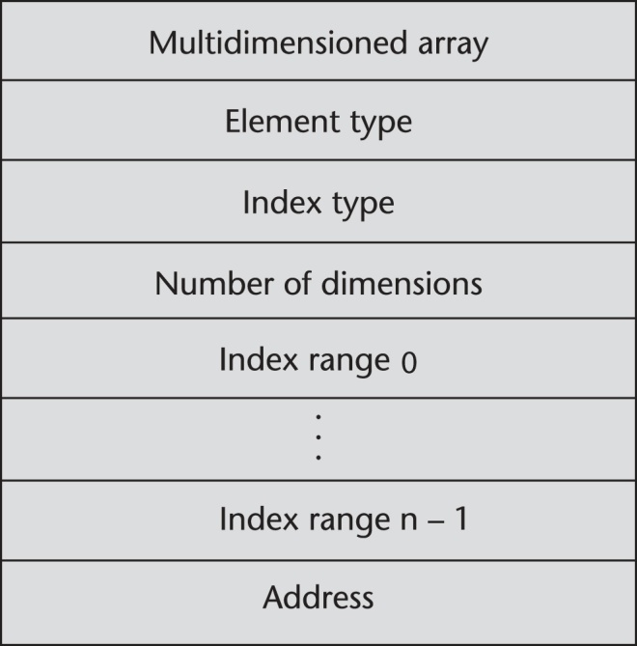
Accessing Multi-dimensioned Arrays
Two common ways:
  Row major order (by rows) – used in most languages
  Column major order (by columns) – used in Fortran
  A compile-time descriptor
  for a multidimensional
  array
Copyright © 2012 Addison-Wesley. All rights reserved.
1-<number>

Slide 40
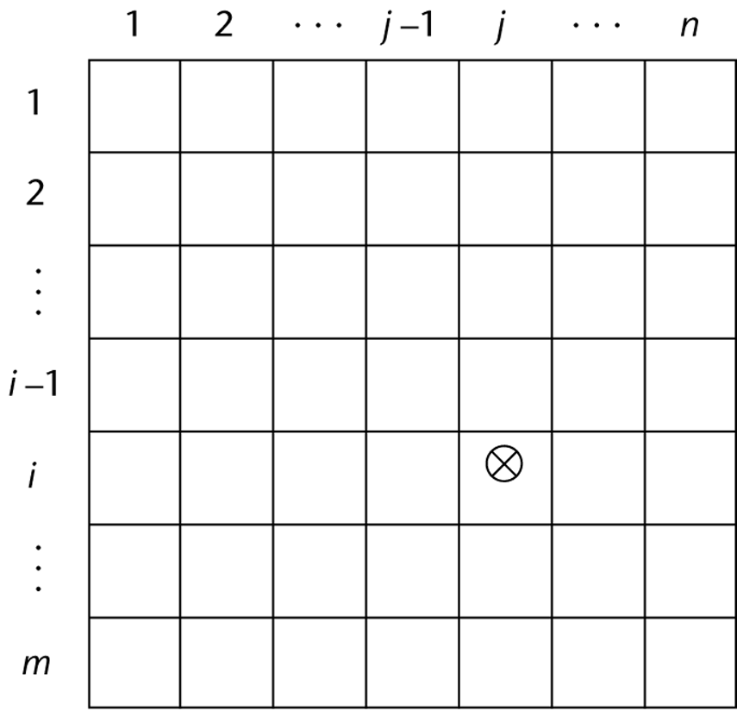
Locating an Element in a Multi-dimensioned Array
General format
  Location (a[I,j]) = address of a [row_lb,col_lb] + (((I - row_lb) * n) + (j - col_lb)) * element_size
Copyright © 2012 Addison-Wesley. All rights reserved.
1-<number>

Slide 41
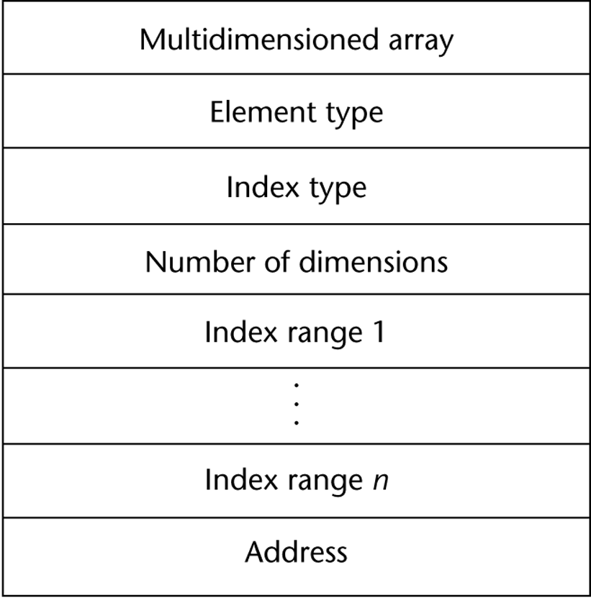
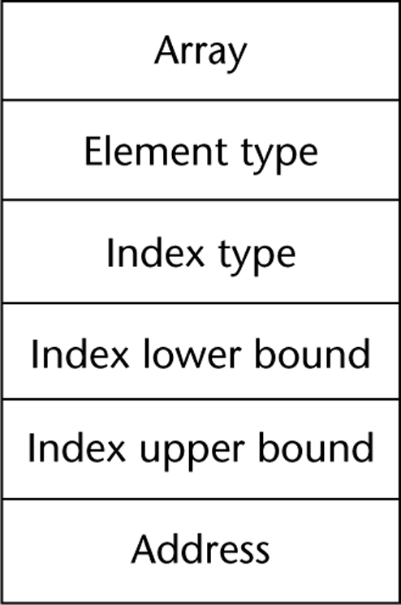
Compile-Time Descriptors
Single-dimensioned array
Multidimensional array
Copyright © 2012 Addison-Wesley. All rights reserved.
1-<number>

Slide 42
Associative Arrays
An associative array is an unordered collection of data elements that are indexed by an equal number of values called keys
  User-defined keys must be stored
Design issues:
- What is the form of references to elements?
- Is the size static or dynamic?
Built-in type in Perl, Python, Ruby, and Lua
  In Lua, they are supported by tables
Copyright © 2012 Addison-Wesley. All rights reserved.
1-<number>

Slide 43
Associative Arrays in Perl
Names begin with %; literals are delimited by parentheses
  %hi_temps = ("Mon" => 77, "Tue" => 79, "Wed" => 65, …);
Subscripting is done using braces and keys
  $hi_temps{"Wed"} = 83;
  Elements can be removed with delete
  delete $hi_temps{"Tue"};
Copyright © 2012 Addison-Wesley. All rights reserved.
1-<number>

Slide 44
Record Types
A record is a possibly heterogeneous aggregate of data elements in which the individual elements are identified by names
Design issues:
  What is the syntactic form of references to the field?
  Are elliptical references allowed
Copyright © 2012 Addison-Wesley. All rights reserved.
1-<number>

Slide 45
Evaluation and Comparison to Arrays
Records are used when collection of data values is heterogeneous
Access to array elements is much slower than access to record fields, because subscripts are dynamic (field names are static)
Dynamic subscripts could be used with record field access, but it would disallow type checking and it would be much slower
Copyright © 2012 Addison-Wesley. All rights reserved.
1-<number>

Slide 46
Tuple Types
A tuple is a data type that is similar to a record, except that the elements are not named
Used in Python, ML, and F# to allow functions to return multiple values
  Python
    Closely related to its lists, but immutable
    Create with a tuple literal
    myTuple = (3, 5.8, ′apple′)
    Referenced with subscripts (begin at 1)
    Catenation with + and deleted with del
Copyright © 2012 Addison-Wesley. All rights reserved.
1-<number>

Slide 47
Tuple Types (continued)
ML
val myTuple = (3, 5.8, ′apple′);
- Access as follows:
#1(myTuple) is the first element
- A new tuple type can be defined
type intReal = int * real;
F#
let tup = (3, 5, 7)
let a, b, c = tup This assigns a tuple to a tuple pattern (a, b, c)
Copyright © 2012 Addison-Wesley. All rights reserved.
1-<number>

Slide 48
List Types
Lists in LISP and Scheme are delimited by parentheses and use no commas
(A B C D) and (A (B C) D)
Data and code have the same form
As data, (A B C) is literally what it is
As code, (A B C) is the function A applied to the
parameters B and C
The interpreter needs to know which a list is, so if it is data, we quote it with an apostrophe
′(A B C) is data
Copyright © 2012 Addison-Wesley. All rights reserved.
1-<number>

Slide 49
List Types (continued)
List Operations in Scheme
  CAR returns the first element of its list parameter
  (CAR ′(A B C)) returns A
  CDR returns the remainder of its list parameter after the first element has been removed
  (CDR ′(A B C)) returns (B C)
  - CONS puts its first parameter into its second parameter, a list, to make a new list
  (CONS ′A (B C)) returns (A B C)
  LIST returns a new list of its parameters
  (LIST ′A ′B ′(C D)) returns (A B (C D))
Copyright © 2012 Addison-Wesley. All rights reserved.
1-<number>

Slide 50
List Types (continued)
List Operations in ML
  Lists are written in brackets and the elements are separated by commas
  List elements must be of the same type
  The Scheme CONS function is a binary operator in ML, ::
  3 :: [5, 7, 9] evaluates to [3, 5, 7, 9]
  The Scheme CAR and CDR functions are named hd and tl, respectively
Copyright © 2012 Addison-Wesley. All rights reserved.
1-<number>

Slide 51
List Types (continued)
F# Lists
  Like those of ML, except elements are separated by semicolons and hd and tl are methods of the List class
Python Lists
  The list data type also serves as Python’s arrays
  Unlike Scheme, Common LISP, ML, and F#, Python’s lists are mutable
  Elements can be of any type
  Create a list with an assignment
  myList = [3, 5.8, "grape"]
Copyright © 2012 Addison-Wesley. All rights reserved.
1-<number>

Slide 52
List Types (continued)
Haskell’s List Comprehensions
  The original
  [n * n | n <- [1..10]]
F#’s List Comprehensions
let myArray = [|for i in 1 .. 5 -> [i * i) |]
Both C# and Java supports lists through their generic heap-dynamic collection classes, List and ArrayList, respectively
Copyright © 2012 Addison-Wesley. All rights reserved.
1-<number>

Slide 53
List Types (continued)
Python Lists (continued)
  List elements are referenced with subscripting, with indices beginning at zero
  x = myList[1] Sets x to 5.8
  List elements can be deleted with del
  del myList[1]
  List Comprehensions – derived from set notation
  [x * x for x in range(6) if x % 3 == 0]
  range(12) creates [0, 1, 2, 3, 4, 5, 6]
  Constructed list: [0, 9, 36]
Copyright © 2012 Addison-Wesley. All rights reserved.
1-<number>

Slide 54
Unions Types
A union is a type whose variables are allowed to store different type values at different times during execution
Design issues
  Should type checking be required?
  Should unions be embedded in records?
Copyright © 2012 Addison-Wesley. All rights reserved.
1-<number>

Slide 55
Discriminated vs. Free Unions
Fortran, C, and C++ provide union constructs in which there is no language support for type checking; the union in these languages is called free union
Type checking of unions require that each union include a type indicator called a discriminant
  Supported by Ada
Copyright © 2012 Addison-Wesley. All rights reserved.
1-<number>

Slide 56
Ada Union Types
type Shape is (Circle, Triangle, Rectangle);
type Colors is (Red, Green, Blue);
type Figure (Form: Shape) is record
Filled: Boolean;
Color: Colors;
case Form is
when Circle => Diameter: Float;
when Triangle =>
Leftside, Rightside: Integer;
Angle: Float;
when Rectangle => Side1, Side2: Integer;
end case;
end record;
Copyright © 2012 Addison-Wesley. All rights reserved.
1-<number>

Slide 57
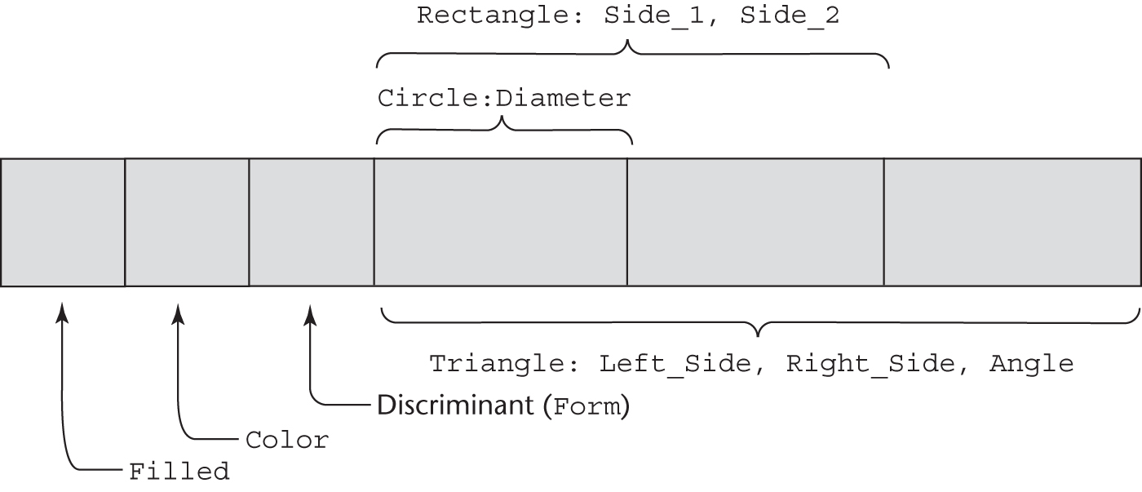
Ada Union Type Illustrated
A discriminated union of three shape variables
Copyright © 2012 Addison-Wesley. All rights reserved.
1-<number>

Slide 58
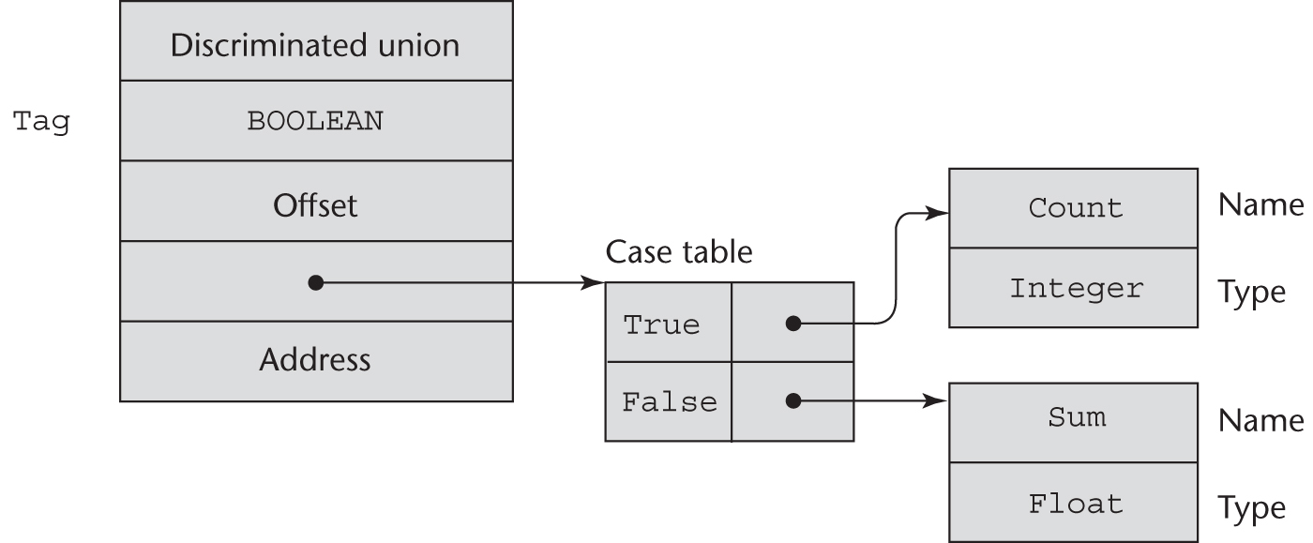
Implementation of Unions
type Node (Tag : Boolean) is
record
case Tag is
when True => Count : Integer;
when False => Sum : Float;
end case;
end record;
Copyright © 2012 Addison-Wesley. All rights reserved.
1-<number>

Slide 59
Evaluation of Unions
Free unions are unsafe
  Do not allow type checking
Java and C# do not support unions
  Reflective of growing concerns for safety in programming language
Ada’s descriminated unions are safe
Copyright © 2012 Addison-Wesley. All rights reserved.
1-<number>

Slide 60
Pointer and Reference Types
A pointer type variable has a range of values that consists of memory addresses and a special value, nil
Provide the power of indirect addressing
Provide a way to manage dynamic memory
A pointer can be used to access a location in the area where storage is dynamically created (usually called a heap)
Copyright © 2012 Addison-Wesley. All rights reserved.
1-<number>

Slide 61
Design Issues of Pointers
What are the scope of and lifetime of a pointer variable?
What is the lifetime of a heap-dynamic variable?
Are pointers restricted as to the type of value to which they can point?
Are pointers used for dynamic storage management, indirect addressing, or both?
Should the language support pointer types, reference types, or both?
Copyright © 2012 Addison-Wesley. All rights reserved.
1-<number>

Slide 62
Pointer Operations
Two fundamental operations: assignment and dereferencing
Assignment is used to set a pointer variable’s value to some useful address
Dereferencing yields the value stored at the location represented by the pointer’s value
  Dereferencing can be explicit or implicit
  C++ uses an explicit operation via *
  j = *ptr
  sets j to the value located at ptr
Copyright © 2012 Addison-Wesley. All rights reserved.
1-<number>

Slide 63
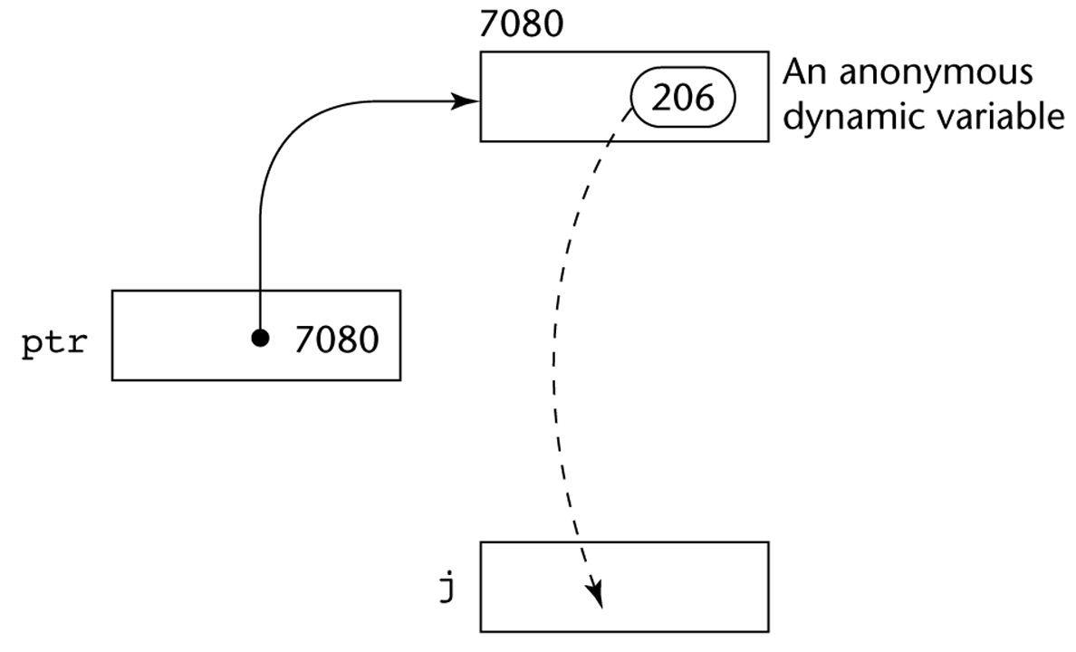
Pointer Assignment Illustrated
The assignment operation j = *ptr
Copyright © 2012 Addison-Wesley. All rights reserved.
1-<number>

Slide 64
Problems with Pointers
Dangling pointers (dangerous)
  A pointer points to a heap-dynamic variable that has been deallocated
Lost heap-dynamic variable
  An allocated heap-dynamic variable that is no longer accessible to the user program (often called garbage)
    Pointer p1 is set to point to a newly created heap-dynamic variable
    Pointer p1 is later set to point to another newly created heap-dynamic variable
    The process of losing heap-dynamic variables is called memory leakage
Copyright © 2012 Addison-Wesley. All rights reserved.
1-<number>

Slide 65
Pointers in Ada
Some dangling pointers are disallowed because dynamic objects can be automatically deallocated at the end of pointer's type scope
The lost heap-dynamic variable problem is not eliminated by Ada (possible with UNCHECKED_DEALLOCATION)
Copyright © 2012 Addison-Wesley. All rights reserved.
1-<number>

Slide 66
Pointers in C and C++
Extremely flexible but must be used with care
Pointers can point at any variable regardless of when or where it was allocated
Used for dynamic storage management and addressing
Pointer arithmetic is possible
Explicit dereferencing and address-of operators
Domain type need not be fixed (void *)
void * can point to any type and can be type
checked (cannot be de-referenced)
Copyright © 2012 Addison-Wesley. All rights reserved.
1-<number>

Slide 67
Pointer Arithmetic in C and C++
float stuff[100];
float *p;
p = stuff;
*(p+5) is equivalent to stuff[5] and p[5]
*(p+i) is equivalent to stuff[i] and p[i]
Copyright © 2012 Addison-Wesley. All rights reserved.
1-<number>

Slide 68
Reference Types
C++ includes a special kind of pointer type called a reference type that is used primarily for formal parameters
  Advantages of both pass-by-reference and pass-by-value
Java extends C++’s reference variables and allows them to replace pointers entirely
  References are references to objects, rather than being addresses
C# includes both the references of Java and the pointers of C++
Copyright © 2012 Addison-Wesley. All rights reserved.
1-<number>

Slide 69
Evaluation of Pointers
Dangling pointers and dangling objects are problems as is heap management
Pointers are like goto's--they widen the range of cells that can be accessed by a variable
Pointers or references are necessary for dynamic data structures--so we can't design a language without them
Copyright © 2012 Addison-Wesley. All rights reserved.
1-<number>

Slide 70
Representations of Pointers
Large computers use single values
Intel microprocessors use segment and offset
Copyright © 2012 Addison-Wesley. All rights reserved.
1-<number>

Slide 71
Dangling Pointer Problem
Tombstone: extra heap cell that is a pointer to the heap-dynamic variable
  The actual pointer variable points only at tombstones
  When heap-dynamic variable de-allocated, tombstone remains but set to nil
  Costly in time and space
. Locks-and-keys: Pointer values are represented as (key, address) pairs
  Heap-dynamic variables are represented as variable plus cell for integer lock value
  When heap-dynamic variable allocated, lock value is created and placed in lock cell and key cell of pointer
Copyright © 2012 Addison-Wesley. All rights reserved.
1-<number>

Slide 72
Heap Management
A very complex run-time process
Single-size cells vs. variable-size cells
Two approaches to reclaim garbage
  Reference counters (eager approach): reclamation is gradual
  Mark-sweep (lazy approach): reclamation occurs when the list of variable space becomes empty
Copyright © 2012 Addison-Wesley. All rights reserved.
1-<number>

Slide 73
Reference Counter
Reference counters: maintain a counter in every cell that store the number of pointers currently pointing at the cell
  Disadvantages: space required, execution time required, complications for cells connected circularly
  Advantage: it is intrinsically incremental, so significant delays in the application execution are avoided
Copyright © 2012 Addison-Wesley. All rights reserved.
1-<number>

Slide 74
Mark-Sweep
The run-time system allocates storage cells as requested and disconnects pointers from cells as necessary; mark-sweep then begins
  Every heap cell has an extra bit used by collection algorithm
  All cells initially set to garbage
  All pointers traced into heap, and reachable cells marked as not garbage
  All garbage cells returned to list of available cells
  Disadvantages: in its original form, it was done too infrequently. When done, it caused significant delays in application execution. Contemporary mark-sweep algorithms avoid this by doing it more often—called incremental mark-sweep
Copyright © 2012 Addison-Wesley. All rights reserved.
1-<number>

Slide 75
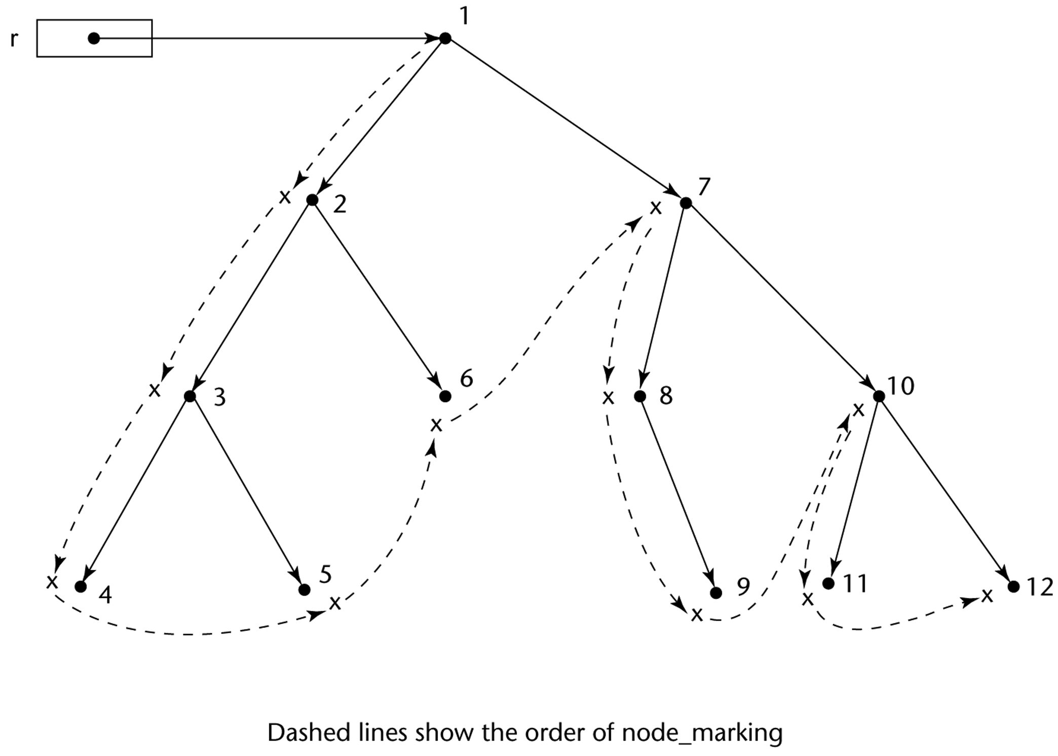
Marking Algorithm
Copyright © 2012 Addison-Wesley. All rights reserved.
1-<number>

Slide 76
Variable-Size Cells
All the difficulties of single-size cells plus more
Required by most programming languages
If mark-sweep is used, additional problems occur
  The initial setting of the indicators of all cells in the heap is difficult
  The marking process in nontrivial
  Maintaining the list of available space is another source of overhead
Copyright © 2012 Addison-Wesley. All rights reserved.
1-<number>

Slide 77
Type Checking
Generalize the concept of operands and operators to include subprograms and assignments
Type checking is the activity of ensuring that the operands of an operator are of compatible types
A compatible type is one that is either legal for the operator, or is allowed under language rules to be implicitly converted, by compiler- generated code, to a legal type
  This automatic conversion is called a coercion.
A type error is the application of an operator to an operand of an inappropriate type
Copyright © 2012 Addison-Wesley. All rights reserved.
1-<number>

Slide 78
Type Checking (continued)
If all type bindings are static, nearly all type checking can be static
If type bindings are dynamic, type checking must be dynamic
A programming language is strongly typed if type errors are always detected
Advantage of strong typing: allows the detection of the misuses of variables that result in type errors
Copyright © 2012 Addison-Wesley. All rights reserved.
1-<number>

Slide 79
Strong Typing
Language examples:
  C and C++ are not: parameter type checking can be avoided; unions are not type checked
  Ada is, almost (UNCHECKED CONVERSION is loophole)
  (Java and C# are similar to Ada)
Copyright © 2012 Addison-Wesley. All rights reserved.
1-<number>

Slide 80
Strong Typing (continued)
Coercion rules strongly affect strong typing--they can weaken it considerably (C++ versus Ada)
Although Java has just half the assignment coercions of C++, its strong typing is still far less effective than that of Ada
Copyright © 2012 Addison-Wesley. All rights reserved.
1-<number>

Slide 81
Name Type Equivalence
Name type equivalence means the two variables have equivalent types if they are in either the same declaration or in declarations that use the same type name
Easy to implement but highly restrictive:
  Subranges of integer types are not equivalent with integer types
  Formal parameters must be the same type as their corresponding actual parameters
Copyright © 2012 Addison-Wesley. All rights reserved.
1-<number>

Slide 82
Structure Type Equivalence
Structure type equivalence means that two variables have equivalent types if their types have identical structures
More flexible, but harder to implement
Copyright © 2012 Addison-Wesley. All rights reserved.
1-<number>

Slide 83
Type Equivalence (continued)
Consider the problem of two structured types:
  Are two record types equivalent if they are structurally the same but use different field names?
  Are two array types equivalent if they are the same except that the subscripts are different?
  (e.g. [1..10] and [0..9])
  Are two enumeration types equivalent if their components are spelled differently?
  With structural type equivalence, you cannot differentiate between types of the same structure (e.g. different units of speed, both float)
Copyright © 2012 Addison-Wesley. All rights reserved.
1-<number>

Slide 84
Theory and Data Types
Type theory is a broad area of study in mathematics, logic, computer science, and philosophy
Two branches of type theory in computer science:
  Practical – data types in commercial languages
  Abstract – typed lambda calculus
A type system is a set of types and the rules that govern their use in programs
Copyright © 2012 Addison-Wesley. All rights reserved.
1-<number>

Slide 85
Theory and Data Types (continued)
Formal model of a type system is a set of types and a collection of functions that define the type rules
  Either an attribute grammar or a type map could be used for the functions
  Finite mappings – model arrays and functions
  Cartesian products – model tuples and records
  Set unions – model union types
  Subsets – model subtypes
Copyright © 2012 Addison-Wesley. All rights reserved.
1-<number>

Slide 86
Summary
The data types of a language are a large part of what determines that language’s style and usefulness
The primitive data types of most imperative languages include numeric, character, and Boolean types
The user-defined enumeration and subrange types are convenient and add to the readability and reliability of programs
Arrays and records are included in most languages
Pointers are used for addressing flexibility and to control dynamic storage management
Copyright © 2012 Addison-Wesley. All rights reserved.
1-<number>

